Slide 1

To-Do-List Project
By Tom Hoey

Slide 2
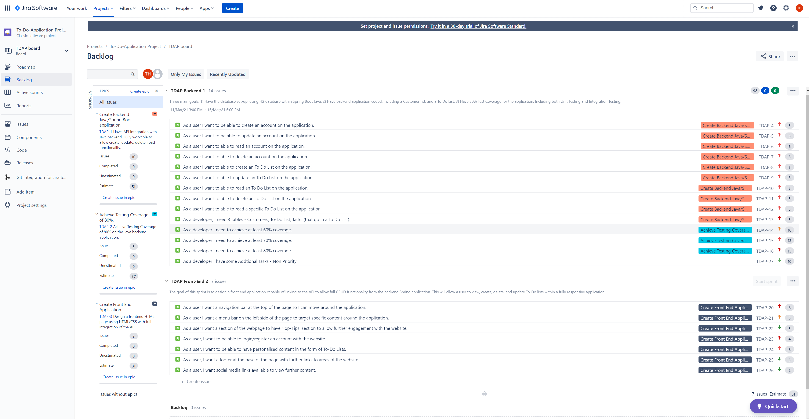
Project Management
Key Points
Two Sprints – One for backend, other for front end.
List of user stories, covering all CRUD functionality within the application.
Each user story has sub-tasks within, which needed to be achieved before moving the story into completed.
Each User Story was assigned to an epic.
Story points and priority was assigned. In cases where the Story points are the same are due to similar workload.

Slide 3
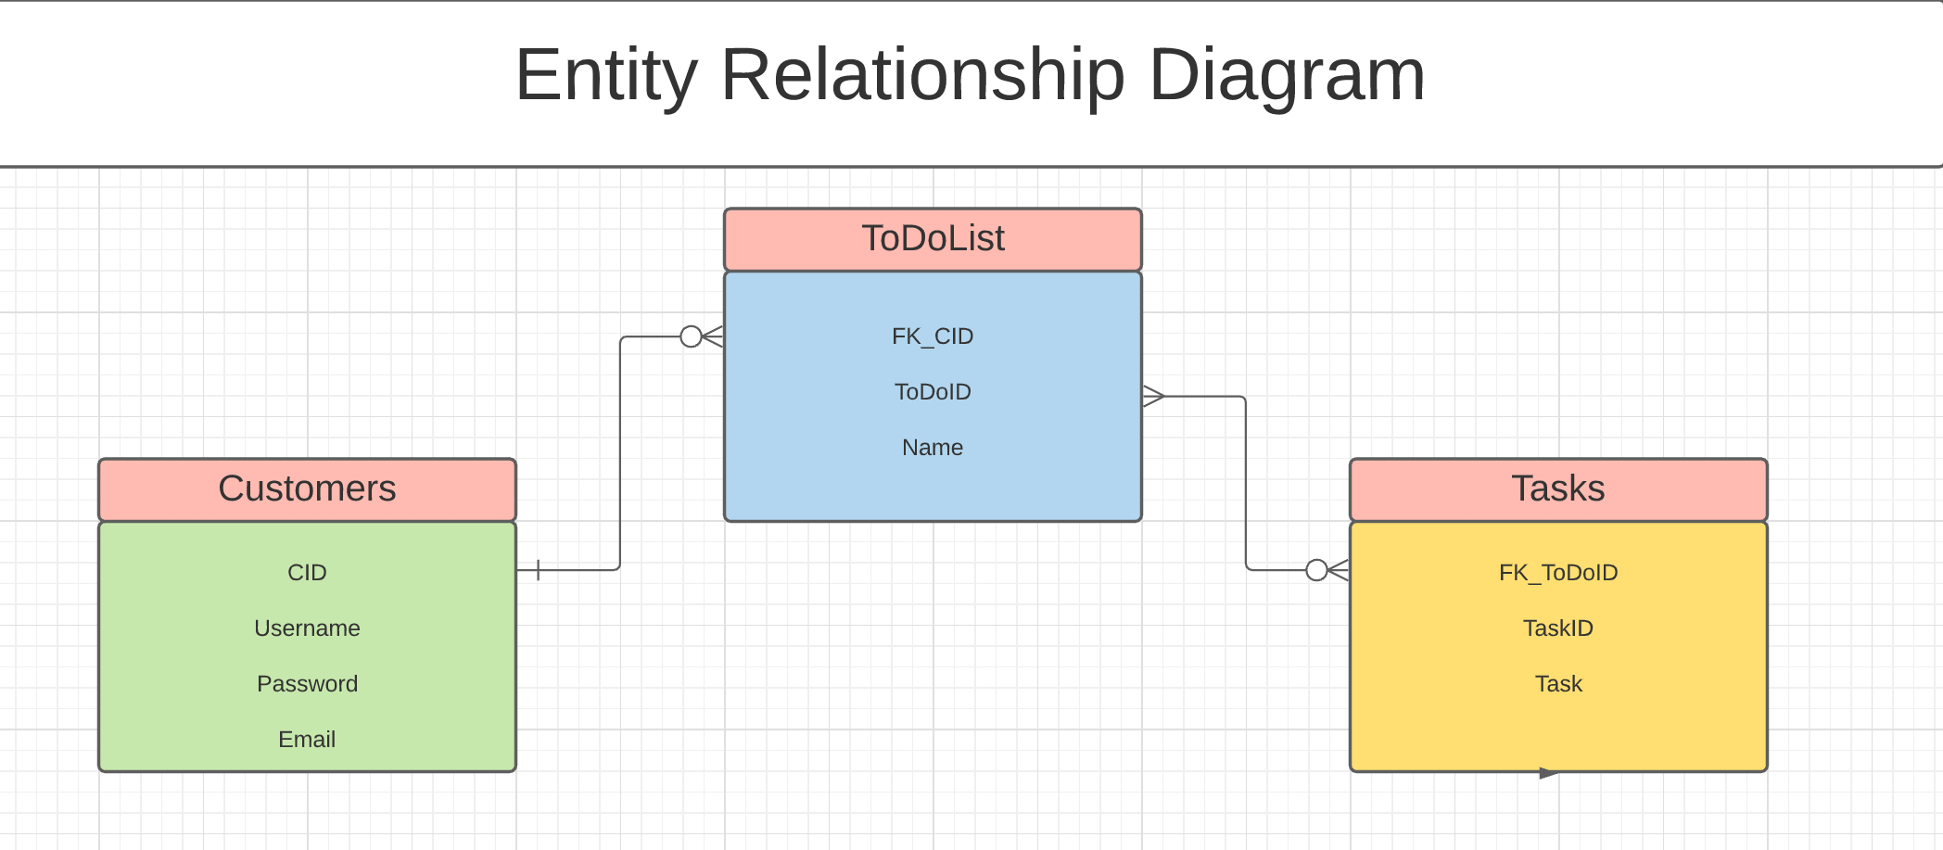
GIT, GitHub, and Agile

Slide 4
Development of the Code

Slide 5
Code Functionality

Slide 6
Testing and Coverage

Slide 7
Front-End Application

Slide 8
Any Questions?

